Slide 1
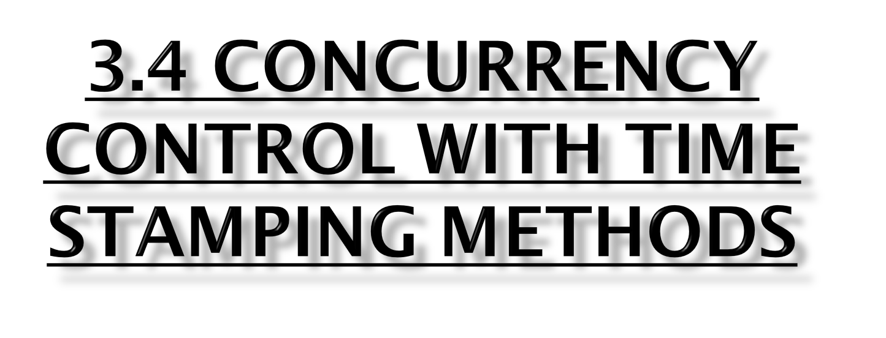
Module III

Slide 2
It assigns a global, unique time stamp to each transaction.
Time stamp value produces an explicit order in which transactions are submitted to the DBMS.
It have two properties: uniqueness and monotonicity
Uniqueness ensures that no equal time stamp values can exist
Monotonicity ensures that time stamp values always increase.

Slide 3
All database operations (Read and Write) within the same transaction must have the same timestamp.
The DBMS executes conflicting operations in time stamp order, thereby ensuring serialisability of the transactions.
If two transactions conflict, one is stopped, rolled back, rescheduled and assigned a new time stamp value.

Slide 4

Each value stored in the database requires two additional time stamp fields: one for the last time the field was read and one for the last update.
Time stamping thus increases memory needs and the databases processing overhead.
Time stamping tends to demand considerable system resources because many transactions may have to be stopped,rescheduled and restamped.

Slide 5

Time stamping methods are used to manage concurrent transaction execution.
Two schemes used to decide which transaction is rolled back and which continues executing:
--the wait/die scheme
--the wound/wait scheme

Slide 6
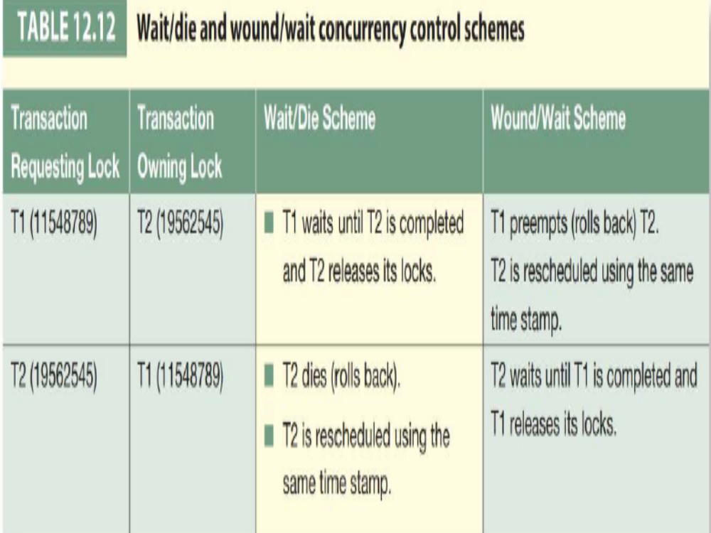

Slide 7
The four possible outcomes are shown in Table.
Two conflicting transactions, T1 and T2, each with a unique timestamp.
T1 has a time stamp of 11548789.
T2 has a time stamp of 19562545.
The time stamps are deduced that T1is the older transaction (the lower time stamp value) and T2is the newer transaction.

Slide 8

If the transaction requesting the lock is the older of the two transactions,
    it will wait until the other transaction is completed
    the locks are released
If the transaction requesting the lock is the younger of the two transactions,
    it will die (roll back)
    is rescheduled using the same time stamp.
The older transaction waits and the younger is rolled back and rescheduled.

Slide 9

If the transaction requesting the lock is the older of the two transactions,
    it will pre-empt(wound) the younger transaction (by rolling it back)
    T1 pre-empts T2 when T1 rolls back T2.
    Younger preempted transaction is rescheduled using the same time stamp.
If the transaction requesting the lock is the younger of the two transactions,
    it will wait until the other transaction is completed
    the locks are released.

Slide 10
The older transaction rolls back the younger transaction and reschedules it.
In both schemes, one of the transactions waits for the other transaction to finish and release the locks.
However, in many cases, a transaction requests multiple locks, that scenario can cause some transactions to wait indefinitely, causing a deadlock.
To prevent that type of deadlock, each lock request has an associated time-out value.
If the lock is not granted before the time-out expires, the transaction is rolled back.

